Slide 1



Multi-key File organization

Slide 2

AGENDA
INTRODUCTION OF MULTI-KEY FILE ORGANIZATION
USES
CHARACTERSTICS
EXAMPLE
TECHNIQUES
INVERTED FILE ORGANIZATION
MULTI-LIST ORGANIZATION

Slide 3

Introduction
In a database or any data structure a key is a unique identifier used to identify each record or element. Traditionally data structures have supported access to data using only one key. However in many scenarios data needs to be accessed and retrieved based on more than one attribute or key . This is where multi-key access comes in.
Multi-key access file organization is commonly used in databases and file systems, where efficient access to data records is critical. It is particularly useful in applications where records need to be accessed based on multiple criteria, such as a customer database where records may need to be accessed based on customer name, phone number, or address.

Slide 4
Uses
Database Management Systems : Multi-key file organization is extensively used in database management systems for efficient storage and retrieval of data. In a database, data is often accessed based on multiple criteria such as customer name, date of purchase, product ID, etc. Multi-key file organization allows for indexing the database based on multiple keys, allowing for faster retrieval of data.
Search Engines : Search engines use multi-key file organization to index web pages based on multiple criteria such as keywords, URL, domain name, etc. This enables faster retrieval of search results, making the search engine more efficient.
File Systems : Multi-key file organization is also used in file systems for efficient storage and retrieval offiles. In a file system, files are often accessed based on multiple criteria such as file name, file type, file size, date modified, etc. Multi-key file organization allows for indexing the file system based on multiple keys, allowing for faster retrieval of files.

Slide 5






CHARACTERSTICS
Improved Query Performance : With multi-key access, data can be retrieved based on multiple criteria without having to scan the entire file. This improves query performance and reduces the time required to retrieve data.
Increased flexibility : Multi-key access allows for more flexible data access. Records can be retrieved based on any combination of keys, allowing for more complex queries and analysis.
Reduced storage requirements : Traditional file organization methods may require redundant data storage to enable efficient access to data based on multiple keys. Multi-key access eliminates.

Slide 6

Customer ID | Customer Name | Phone Number | Order Date | Order Amount
210008011 | JATIN | 7015123015 | 9-FEB-2023 | $ 400
210008013 | NIKHIL | 9034533078 | 8-MAR-2023 | $ 500
210008024 | TANISHAK | 9813953721 | 6-MAR-2023 | $ 200
210008017 | SHIVENDER | 9929049947 | 8-FEB-2023 | $ 400
210008021 | NITIN | 7206782399 | 8-MAR-2023 | $ 300
Example
To understand the concept , consider the following file

Slide 7
Techniques
There are numerous techniques that have been used to implement multi-key files . Most of the techniques are based on building indexes to provide direct access by key value..
1.Inverted file organization
2.Multi-List organization

Slide 8
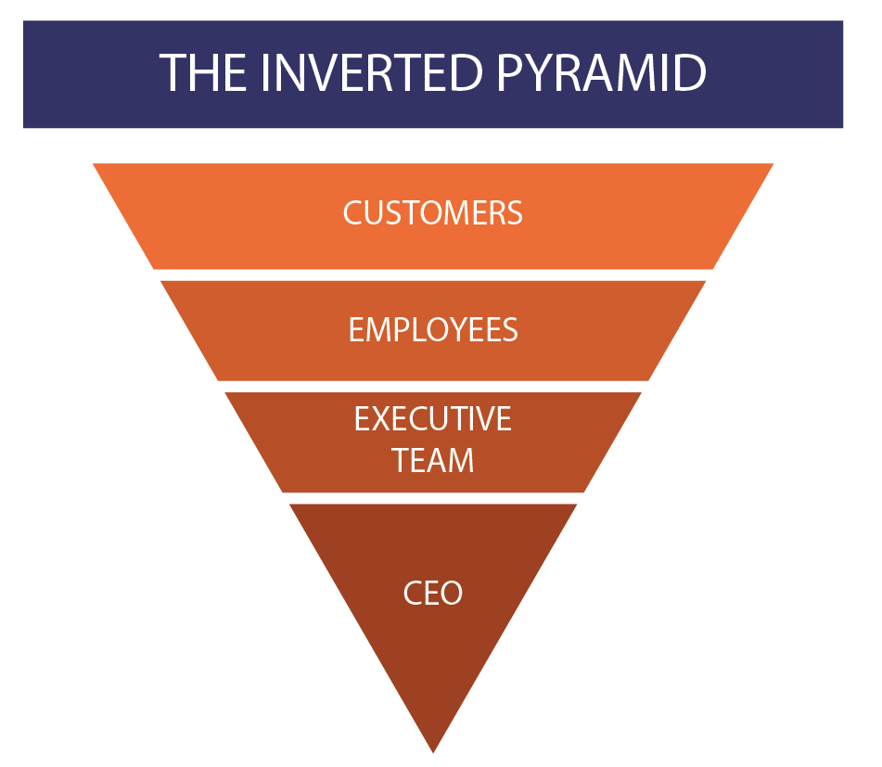

Inverted - File Organization

Slide 9
Inverted - File Organization
Inverted file organization is a data structure used for efficient retrieval of information from a large collection of documents or records.
It is commonly used in search engines and databases to provide fast search results. Inverted file organization is based on the concept of indexing, where an index is created for each word or term in the collection of documents.
The index contains a list of all the documents that contain that particular word or term. This list is called the inverted list, and it stores the locations of the documents where the term appears.

Slide 10
Advantages
Fast retrieval : Inverted file organization is designed to provide fast retrieval of data based on multiple search criteria. The use of indexes and inverted lists allows for quick access to the documents that match the search criteria, resulting in faster search results.
Scalability : Inverted file organization is highly scalable and can handle large amounts of data. As the size of the data set grows, the performance of inverted file organization remains relatively constant, making it an ideal choice for applications that require the handling of large volumes of data.
Flexibility : Inverted file organization can be used to search on multiple keys or attributes, allowing for complex queries with multiple search criteria. This makes it a powerful tool for multi-key access, as it allows users to find the information they need using various search criteria.

Slide 11
Disadvantages
Increased complexity : Inverted file organization can become more complex as the number of keys or attributes being indexed increases. This complexity can make it more difficult to maintain and optimize the system.
Storage overhead: Inverted file organization requires additional storage space to store the indexes and inverted lists. As the size of the data set grows, the storage overhead can become significant.
Query processing overhead: Inverted file organization requires extra processing overhead to perform the set operations needed to retrieve data based on multiple search criteria.

Slide 12
Example
NAME | AGE | GENDER | ADDRESS | MAJOR
JATIN | 20 | M | 33,Main ST. | CS
NIKHIL | 19 | M | 145,Elm ST. | CS
TANYA | 20 | F | 111,Palm ST. | CE
TANISHAK | 19 | M | 100,Pine ST. | MECHE
NANCY | 19 | F | 106,Cherry ST. | CE
To understand the example ,consider the student file

Slide 13
In above table in previous slide. We want to be able to quickly search for students based on their major.
One way to do this would be to organize the student records by major, with each major having its own file. However, this approach can be inefficient, especially if there are many different majors, as it requires searching through multiple files to find the desired information.
Instead, we can use an inverted file organization to index the contents of the student records by major. We create an index file that lists each major and the corresponding student records. This allows us to quickly locate all the students who have a particular major without having to search through all the student records.

Slide 14
Here's an example of how an inverted file organization for a student file might look like
Major​ | Student Records​
CS​ | Jatin,20,M,33 Main ST,CS​
CS​ | Nikhil,19,M,145 Elm ST,CS​
CE​ | Tanya,20,F,111 Palm ST,CE​
MECHE​ | Tanishak,19,M,100 Pine ST ,MECHE​
CE​ | Nancy,19,F,106 Cherry ST,CE​

Slide 15
Multi –List Organization
Multi-list organization is a type of organization used in multi-key file organization, which is a technique for organizing data in a database. In multi-key file organization, data is stored in a file based on multiple keys, rather than just one key as in traditional file organization. This allows for more efficient searching and retrieval of data based on different criteria.

Slide 16
Advantages
Improved Data Organization: Multi list organization enables the organization of complex data structures within a single record or entity, making it easier to manage and access data.
Easy Access to Data: With multi list organization, it is easier to access and manipulate the data since the related data items are stored in the same record or entity.
Efficient Memory Utilization: Multi list organization can help in efficient memory utilization since the data items are stored in a single record or entity, minimizing the need for multiple data structures.

Slide 17
Disadvantages
Complexity : The implementation of multi list organization can be complex, especially for large and complex data structures.
Limited Scalability : Multi list organization can be limited in scalability, especially when dealing with a large amount of data since storing all the data in a single record or entity can lead to performance issues.
Higher Processing Time : Since related data items are stored within a single record or entity, it can lead to increased processing time when accessing and manipulating the data.

Slide 18
Example
Student ID | Name | Address | Age | Courses | Grades | Activities
001 | John | 123 Main St | 18 | {CSC101, ENG101, MAT101} | {A, B, A} | {Chess Club, Debate Team}
002 | Jane | 456 Elm St | 20 | {CSC201, MAT201} | {C, A} | {Volleyball Team}
003 | Bob | 789 Oak St | 19 | {CSC101, ENG101, HIS101} | {B, A, C} | {Student Government}

Slide 19


